Slide 1
Object-Functional patterns in Scala
Vitaliy Savkin
Software Engineer
EPAM Systems
https://github.com/Vitaliy-Savkin/scala_patterns

Slide 2
Topic of presentation
Design pattern is a general reusable solution to a commonly occurring problem within a given context in software design.
Design patterns reside in the domain of modules and interconnections.
Architectural patterns
Design patterns
Algorithms & code style guides
A good language helps to make design better

Slide 3
Features of Scala influencing the Design
Functions as first-class citizens
Advanced OO techniques
Strong type system
Encouraged immutability

Slide 4
Functions syntax
// lambda
val inc1 = (x: Int) => x + 1
val inc2 = (_: Int) + 1
val inc3: Int => Int = _ + 1
// closures
val const = 10
val addConst = (x: Int) => x + const
// method
class Foo { def inc(i: Int): Int = i + 1 }
// methods as functions
val foo = new Foo
val f: Int => Int = foo.inc _

Slide 5
Functions syntax
// partially defined function
val fac: PartialFunction[Int, Int] = {
case 0 | 1 => 1
case n if n > 1 => n * fac(n - 1)
}
// curried function
val add = (x: Int) => (y: Int) => x + y
val inc = add(1)
// high-order function
val applyToDoubled = (f: Int => Int) => (x: Int) => f(2 * x)
val incDoubled: Int => Int = applyToDoubled(inc)
incDoubled(10) // 21

Slide 6
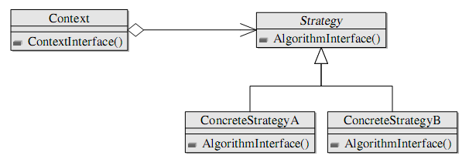
Strategy
Strategy pattern
defines a family of algorithms
encapsulates each algorithm
makes the algorithms interchangeable within that family

Slide 7
Strategy
class Layout(layoutStrategy: (Point, Block) => Point)
val globalContext: Context = ...
// Place extra data using currying
val horizontal: Context => (Point, Block) => Point
val vertical: Context => (Point, Block) => Point
val layout = new Layout(horizontal(globalContext))
// Place extra data using closures:
// use globalContext here
val horizontal: (Point, Block) => Point = ...
val vertical: (Point, Block) => Point = ...
val layout = new Layout(horizontal)

Slide 8
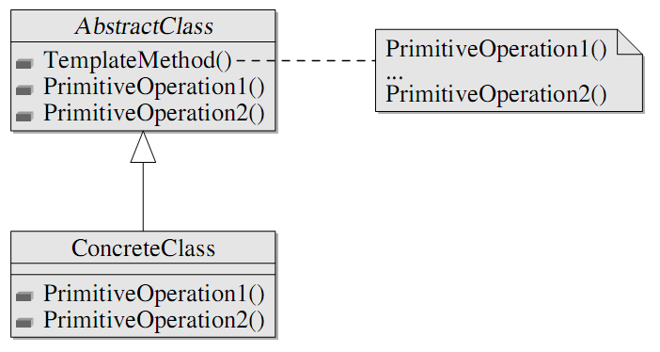
Template Method
Template method pattern
defines the program skeleton of an algorithm in a method, which defers some steps to subclasses

Slide 9
Template Method
trait GameState { def winner(): Int }
class Game(initialState: GameState,
endOfGame: GameState => Boolean,
makePlay: (GameState, Int) => GameState){
def playGame(playersCount: Int): Int = {
var state = initialState
var i = 0
while(!endOfGame(state)){
state = makePlay(state, i)
i = (i + 1) % playersCount
}
state.winner()
}
}

Slide 10
Template Method
case class GameRules(
endOfGame: GameState => Boolean,
makePlay: (GameState, Int) => GameState,
playersCount: Int)
@tailrec
def playGame(gameRules: GameRules,
state: GameState,
currPlayer: Int): Int =
if(gameRules.endOfGame(state)) state.winner()
else playGame(gameRules,
gameRules.makePlay(state, currPlayer),
(currPlayer + 1) % gameRules.playersCount)

Slide 11
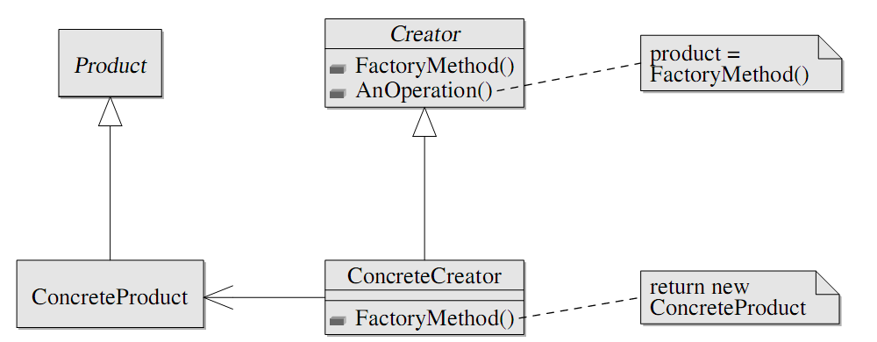
Factory Method
Factory method pattern
deals with the problem of creating objects without specifying the exact class of object that will be created

Slide 12
Factory Method
trait Room { def connect(other: Room): Unit }
trait MagicRoom extends Room
trait OrdinaryRoom extends Room
trait Treasure
class Maze(makeRoom: Treasure => Room){
val room1 = makeRoom(randomTreasure())
val room2 = makeRoom(randomTreasure())
room1.connect(room2)
val rooms = List(room1, room2)
def randomTreasure(): Treasure = ...
}

Slide 13
Factory Method
val ordinaryRoom: Color => Treasure => OrdinaryRoom = ...
val magicRoom: Treasure => MagicRoom = ...
val greenMaze = new Maze(ordinaryRoom(Color.Green))
val magicMaze = new Maze(magicRoom)
// Note that Treasure => MagicRoom is a subtype of
// Treasure => Room because of covariance.

Slide 14
Variances
If type T[+A] is covariant by type argument A then
∀ A1 <: A2 => T[A1] <: T[A2]
Example:
immutable collections by type of elements
functions by return type (call-side is able to deal with any subtype of type he expects to be returned from function)
If type T[-A] is contravariant by type argument A then
∀ A1 >: A2 => T[A1] <: T[A2]
Example:
functions by types of arguments (function is able to deal with any subtypes of types it expects to be passed to)

Slide 15
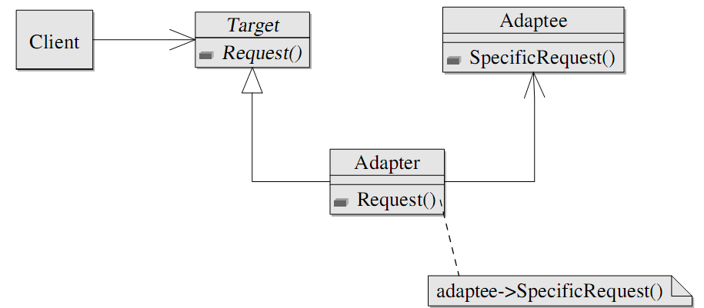
Adapter
Adapter pattern
allows the interface of an existing class to be used from another interface

Slide 16
Adapter
trait StringProvider { def getStringData: String }
val show: StringProvider => Unit
trait Message {// how to show it?
def user: String
def data: String
}
val formatMessage: Message => StringProvider = m =>
new StringProvider {
def getStringData: String = m.user + " said " + m.data
}
val showMessage: Message => Unit = formatMessage andThen show

Slide 17
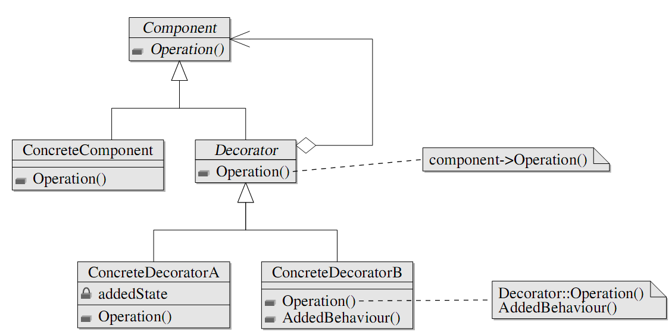
Decorator
Decorator pattern
allows behavior to be added to an individual object
without affecting the behavior of other objects from the same class

Slide 18
Decorator
val fileInputStream: String => FileInputStream = ...
val bufferedInputStream: InputStream => BufferedInputStream = ...
val gzipInputStream: InputStream => GZIPInputStream = ...
val objectInputStream: InputStream => ObjectInputStream = ...
val getStream = fileInputStream andThen bufferedInputStream andThen
gzipInputStream andThen objectInputStream
val deserializationStream = getStream("objects.gz")
val obj = deserializationStream.readObject()
deserializationStream.close()

Slide 19
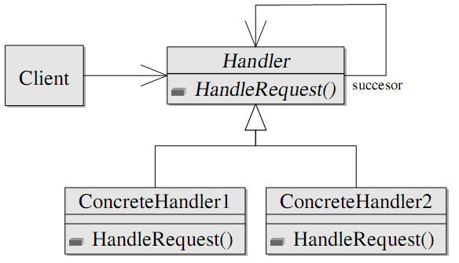
Chain of Responsibility
Chain of responsibility pattern
avoids coupling the sender of a request to its receiver by giving more than one object a chance to handle the request
chains the receiving objects and pass the request along the chain until an object handles it

Slide 20
Chain of Responsibility
val storeEmpty: PartialFunction[String, Unit] =
{ case "" => logger.error("Empty message") }
val storeShort: PartialFunction[String, Unit] =
{ case s if s.length < 256 => writeToDB(s) }
val storeLong: PartialFunction[String, Unit] =
{ case s if s.length >= 256 => writeToDB(compress(s)) }
val storeMessage = storeEmpty orElse storeShort orElse storeLong

Slide 21
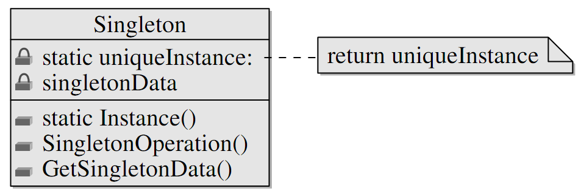
Singleton
Singleton pattern
restricts the instantiation of a class to one object

Slide 22
Singleton
trait Locale {
def getMessage(key: String): String
}
object MessageBox{
def show(message: String): String = ...
def show(messageKey: String, locale: Locale): String =
show(locale.getMessage(messageKey))
}
class ConfigBasedLocale(configFile: String) extends Locale{
def getMessage(key: String): String =
// get messages from config
}

Slide 23
Singleton
MessageBox.show(
"FileNotFoundError",
new ConfigBasedLocale("user_defined.conf"))
object English extends ConfigBasedLocale("english.conf")
object French extends ConfigBasedLocale("french.conf")
MessageBox.show("FileNotFoundError", English)
MessageBox.show("FileNotFoundError", French)

Slide 24
Traits
Traits:
are interfaces with non-abstract methods
implement safe multiple inheritance (mixin class composition)
provide a way of declaration of dependencies

Slide 25
Traits
trait Logger {
def log(msg: String): Unit
def logInfo(msg: String) = log("[Info] " + msg)
def logError(msg: String) = log("[Error] " + msg)
}
trait ConsoleLogger extends Logger {
def log(msg: String) { println(msg) }
}
trait FileLogger extends Logger { ... }

Slide 26
Traits
class Account {
self: Logger => // requires-a relation
var balance = 0
def withdraw(amount: Double) {
if (amount > balance) self.logError("Insufficient funds")
else self.logInfo("...")
}
}
class AccountCL extends Account with ConsoleLogger
val acc = new AccountCL

Slide 27
Traits
trait ShowAccount {
self: Account =>
def show = "Balance: " + self.balance
}
val acc1 = new Account with ConsoleLogger with ShowAccount
acc1.show // ok
val acc2 = new Account with ConsoleLogger
acc2.show // error

Slide 28
Revisiting Decorator: Stackable Trait Pattern
trait IntQueue {
def get(): Int
def put(x: Int)
}
class BasicIntQueue extends IntQueue {
private val buf = new ArrayBuffer[Int]
def get() = buf.remove(0)
def put(x: Int) { buf += x }
}

Slide 29
Revisiting Decorator: Stackable Trait Pattern
trait Doubling extends IntQueue {
abstract override def put(x: Int) { super.put(2 * x) }
}
trait Incrementing extends IntQueue {
abstract override def put(x: Int) { super.put(x + 1) }
}
val queue1 = new BasicIntQueue with Doubling with Incrementing
queue1.put(10)
queue1.get() //22
val queue2 = new BasicIntQueue with Incrementing with Doubling
queue2.put(10)
queue2.get() //21

Slide 30
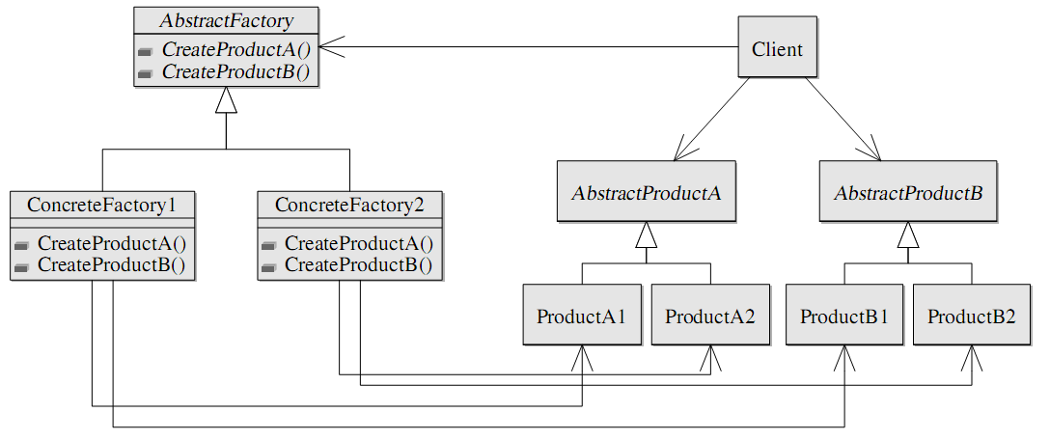
Abstract factory - Family polymorphism
Abstract factory pattern
provides an interface for creating families of related or dependent objects
without specifying the concrete classes

Slide 31
Abstract factory - Family polymorphism
trait WindowFactory{
type aWindow <: Window
type aScrollbar <: Scrollbar
def createWindow(s: aScrollbar): aWindow
def createScrollbar(): aScrollbar
abstract class Window(s: aScrollbar)
abstract class Scrollbar
}

Slide 32
Abstract factory - Family polymorphism
object VistaFactory extends WindowFactory{
type aWindow = VistaWindow
type aScrollbar = VistaScrollbar
def createWindow(s: aScrollbar) = new VistaWindow(s)
def createScrollbar() = new VistaScrollbar
protected class VistaWindow(s:VistaScrollbar) extends Window(s)
protected class VistaScrollbar extends Scrollbar
}
def get(os: String): WindowFactory =
if(os == “vista”) VistaFactory else if …

Slide 33
Abstract factory - Family polymorphism
Advantages of FP:
Impossible to mix products from different factories.
val vista = get(“vista")
val window1: vista.Window =
vista.createWindow(vista.createScrollbar())
val window2 = // type error
vista.createWindow(
get("default").createScrollbar())
Singleton factories are trivial to implement.
Implementation classes are easily hidden from clients.

Slide 34
Dependency Injection - Cake Pattern
Dependency Injection
is a pattern that implements inversion of control
is the passing of a dependency (a service) to a dependent object (a client).
Dependency injection involves four elements:
the client object depending on the service
the interface the client uses to communicate with the service
the implementation of a service object
the injector object, which is responsible for injecting the service into the client

Slide 35
Dependency Injection - Cake Pattern
// the first piece of cake
trait NameProviderComponent {
val nameProvider: NameProvider
trait NameProvider { def getName: String }
}
// the second one
trait SayHelloComponent {
val sayHelloService: SayHelloService
trait SayHelloService { def sayHello: Unit }
}
trait Components extends NameProviderComponent
with SayHelloComponent

Slide 36
Dependency Injection - Cake Pattern
trait NameProviderComponentImpl extends NameProviderComponent {
val nameProvider: NameProvider = new NameProviderImpl
private class NameProviderImpl extends NameProvider {
def getName: String = "World"
}}
trait SayHelloComponentImpl extends SayHelloComponent {
self: NameProviderComponent =>
val sayHelloService: SayHelloService = new SayHelloServiceImpl
private class SayHelloServiceImpl extends SayHelloService {
def sayHello: Unit =
println("Hello, " + self.nameProvider.getName)
}}

Slide 37
Dependency Injection - Cake Pattern
object MyApplication {
object Components extends Components
with SayHelloComponentImpl
with NameProviderComponentImpl
class Client(c: Components) {
def run() = c.sayHelloService.sayHello }
def main(args: Array[String]) = new Client(Components).run()
// OR
class Client { c: Components =>
def run() = c.sayHelloService.sayHello }
def main(args: Array[String]) =
(new Client with Components with SayHelloComponentImpl
with NameProviderComponentImpl).run() }

Slide 38
Dependency Injection - Cake Pattern
Advantages:
Compile-time check: forgotten dependencies break build
The same language is in use
Disadvantage:
Configuration can not be changed in run-time

Slide 39
Dependency Injection - Cake Pattern
Fix (for the first case)
write *.scala configuration file
load & compile it in runtime
from compiled classes select a class which implements Components and instantiate it using reflection
pass created instance to a client

Slide 40
Dependency Injection - Cake Pattern
Fix (for the second case)
Use scala as scripting language: write a simple startup script
val test = args(0).toBoolean // command line argument
val client = if(test) new Client with Components
with SayHelloComponentImpl with TestNameProviderComponentImpl
else new Client with Components
with SayHelloComponentImpl with NameProviderComponentImpl
client.run()
run the script from the command line
scala -cp first.jar:second.jar startup.scala true

Slide 41
Value object
Value object
is a small immutable object
that represents a simple entity
whose equality is not based on identity
case class UInt(signed: Int)

Slide 42
Value object
case class Point(x: Int, y: Int, z: Int)
// looks fine
val movePointZ = (dz: Int) => (p: Point) => p.copy(z = p.z + dz)
case class Location(room: Room, p: Point)
// there is some code smell
val moveLocZ = (dz: Int) => (l: Location) =>
l.copy(p = l.p.copy(z = l.p.z + dz))
case class Object(l: Location, weight: Int)
// awful
val moveObjZ = (dz: Int) => (o: Object) =>
o.copy(l = o.l.copy(p = o.l.p.copy(z = o.l.p.z + dz)))

Slide 43
Lenses
Lenses
generalize properties (i.e. accessors/mutators)
provide a way of “mutation” of immutable objects
case class Lens[S, P](get: S => P, set: S => P => S){
val modify: S => (P => P) => S =
(s: S) => (f: P => P) => set(s)(f(get(s)))
def andThen[T](next: Lens[P, T]): Lens[S, T] =
new Lens[S, T](s => next.get(this.get(s)),
s => v => this.modify(s)(next.set(_)(v)))
}

Slide 44
Lenses
// There are libraries reducing boilerplate code below
val pointZ = new Lens[Point, Int](
p => p.z, p => v => p.copy(z = v))
val locPoint = new Lens[Location, Point](
l => l.p, l => v => l.copy(p = v))
val objLoc = new Lens[Object, Location](
o => p.l, o => v => o.copy(l = v))
val objZ:Lens[Object,Int]= objLoc andThen locPoint andThen pointZ
val moveZ = (dz: Int) => (o: Object) => objZ.modify(o) { _ + dz }

Slide 45
Benefits of immutability
Why so complex?
immutable objects are easier/simpler to reason about
less state - less area of analysis
removes classes of bugs caused by state
usage as keys of hashtables
objects comparison
wrong order of concurrent access to shared data
removes some design problems
Circle-ellipse problem

Slide 46
Circle-ellipse problem
class Ellipse(xSize: Float, ySize: Float){
var x = xSize
var y = ySize
def stretchX(dx: Float) { x += dx }
def stretchY(dy: Float) { y += dy }
}
class Circle(radius: Float) extends
Ellipse(2 * radius, 2 * radius)
// circle's contract x == y is satisfied
// but could be violated after call of stretchX or stretchY

Slide 47
Circle-ellipse problem
// extensible class hierarchy
class Ellipse(val x: Float, val y: Float){
def stretchX(dx: Float): Ellipse = new Ellipse(x + dx, y)
def stretchY(dy: Float): Ellipse = new Ellipse(x, y + dy)
}
class Circle(val radius: Float) extends
Ellipse(2 * radius, 2 * radius){
def stretch(d: Float): Circle = new Circle(radius + d / 2)
// methods stretchX and stretchY are still available
// but do not return Circles
}
Problem: an ellipse can not become a circle

Slide 48
Circle-ellipse problem
// sealed class hierarchy
sealed class Ellipse(val x: Float, val y: Float)
sealed class Circle(val radius: Float) extends
Ellipse(2 * radius, 2 * radius)
def stretchX(e: Ellipse, dx: Float): Ellipse =
if (dx == 0) e
else if (e.x + dx == e.y) new Circle(e.y / 2)
else new Ellipse(e.x + dx, e.y)
def stretchY(e: Ellipse, dy: Float): Ellipse =
if (dy == 0) e
else if (e.y + dy == e.x) new Circle(e.x / 2)
else new Ellipse(e.x, e.y + dy)

Slide 49
QUESTIONS?

Slide 50
THANKS FOR ATTENTION

